Slide 1
CNN

Slide 2



The convolution operation
The convolution operation consists of sliding a kernel (also called weights) across the dimensions of a tensor and computing the sum of products of the corresponding tensor values and weights
i₀
$$∙$$
k₀
i₀
i₁
$$∙$$
k₁
$$i0∙k0 + i1∙k1 + i2∙k2$$
k₀
$$∙$$
i₁
i₂
$$∙$$
k₂
$$i1∙k0 + i2∙k1 + i3∙k2$$
k₁
$$∙$$
i₂
i₃
....
k₂
$$∙$$
i₃
kernel
i₄
....
i₄
i₅
i₅
output tensor
Input tensor

Slide 3
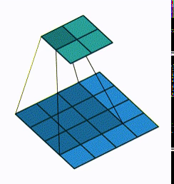
The convolution operation in 2D
In 2D the convolutional kernel slides across the width and height of the input tensor.
For a 2D convolution:
If the input is a two-dimensional tensor
The kernel is a two-dimensional tensor
If the input is a three-dimensional tensor (like an RGB image [w x h x 3])
The kernel is a three-dimensional tensor with the last dimension matching the one of the input
The input can be a four-dimensional tensor but the first dimension must be the batch one

Slide 4
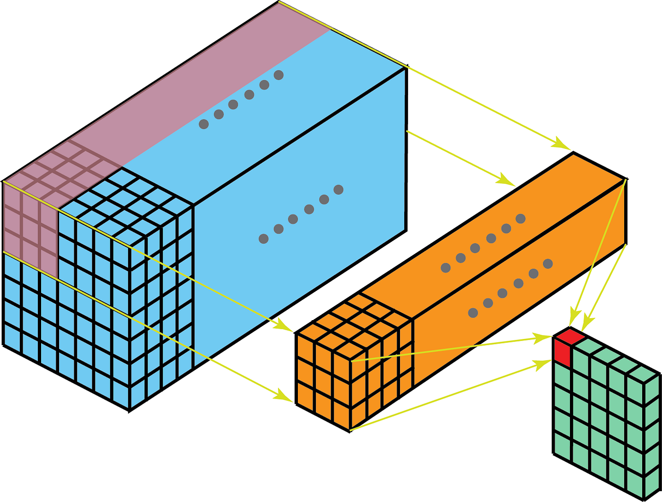
The convolution operation in 2D
In the 2D convolution the last dimension of the input tensor and kernel must match
Input tensor H_{i} x W_{i} x D
Kernel H_{k} x W_{k} x D
The output is:
H_{o} x W_{o} x 1
The depth dimension
is called “channels”

Slide 5
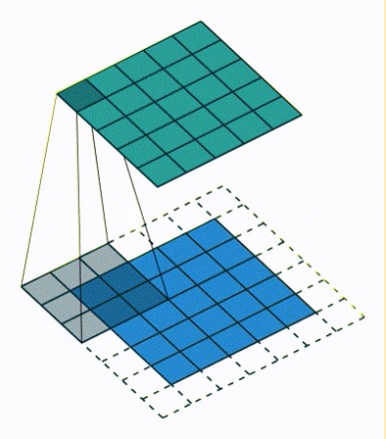
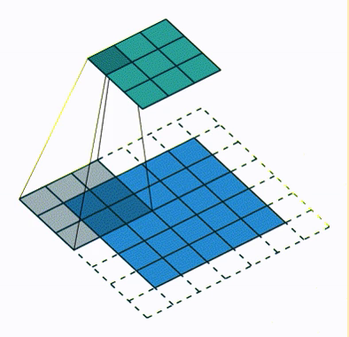
Convolution: padding and stride
Padding means adding extra pixels (zeros, for example) around the input tensor. This is done to ensure that the convolutional operation can process the entire input, especially at the edges.
Stride refers to the step size at which the convolutional kernel moves across the input tensor. A larger stride results in a smaller output size, as the kernel skips more pixels with each step.

Slide 6
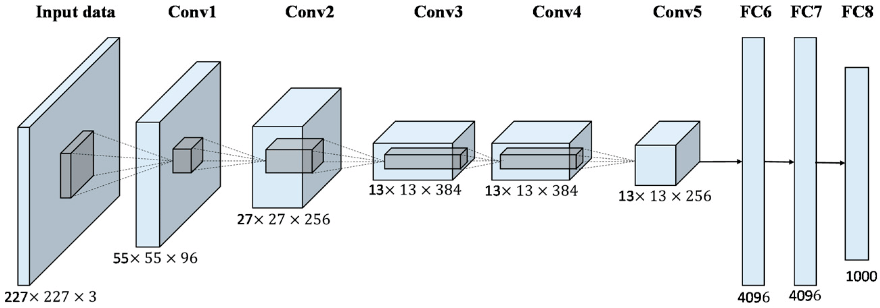
A 2D convolution with N output channels
In this example the first convolution is using an 11x11x3 kernel with stride=4, the input tensor is 227x227x3 and the output is 55x55x96.
Shouldn’t be 55x55x1?
Yes. There are 96 11x11x3 kernels.

Slide 7

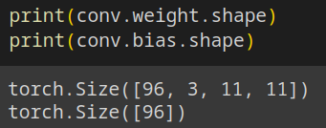
Conv2d layer in PyTorch
The Conv2d layer in PyTorch performs N convolutions with N kernels over the same input tensor and add a bias to each result, the output of the Conv2D layer is a tensor with a depth of N
Input channels
output channels
kernel size
arguments

Slide 8
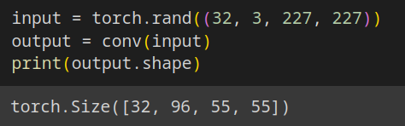
Conv2d layer in PyTorch
The convolutions are carried out in parallel.
Since the machine needs to perform the same operation over multiple inputs it can exploit the SIMD paradigm.
That's why GPU are perfect for this kind of operation.

Slide 9
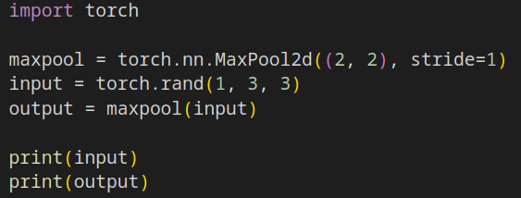
Pooling Layers
You can reduce the height and width dimensions of a three-dimensional tensor using a convolution with a stride or you can use a pooling layer.
A pooling layer is a layer that applies a reduction operation over a convolution sliding window.

Slide 10
Activation functions
Activation functions introduce non-linearity into the model.
Convolutions are linear operations and a composition of linear operations is a linear operation.
A composition of convolutions is equal to a single convolution.
By following each linear operation with a non-linearity this problem is solved
Common activation functions include:
Sigmoid
Squashes values between 0 and 1
Hyperbolic Tangent (tanh)
Squashes values between -1 and 1
Rectified Linear Unit (ReLU)
Replaces negative values with zero

Slide 11
Anatomy of a Convolutional Neural Network
Conv2d
Pool
(optional)
Activation
Repeat
N times
...
output first layer
width and height decreases
depth (channels) increases
input

Slide 12
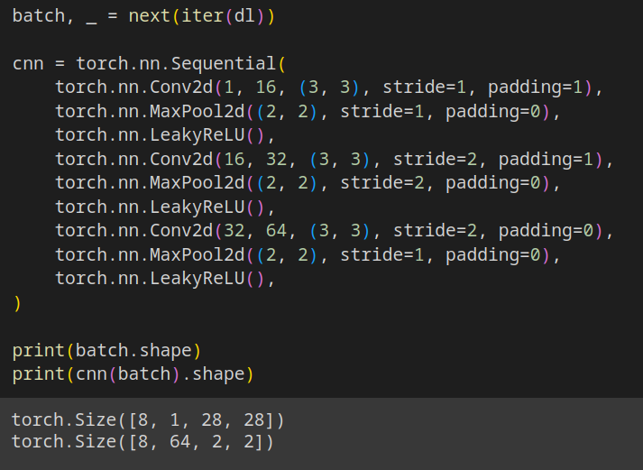
Convolutional Neural Network in PyTorch

Slide 13
Residual Networks (ResNet)
ResNet is a deep learning architecture designed to address the challenge of training very deep neural networks.
It introduces the concept of residual blocks, where the input to a block is combined with its output through skip connections.
These skip connections allow the gradient to flow more directly through the network during training, mitigating the vanishing gradient problem
Convolution
+
How to make a convolution
without changing the tensor shape?

Slide 14
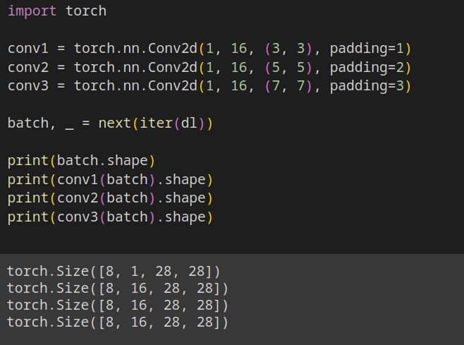
Residual Networks (ResNet): half-padding
To make a convolution which preserve the tensor shape you have to use half-padding. The padding must be half of the kernel size.
I still cant sum the
output with the input
because the number of
channels is different

Slide 15
Residual Networks (ResNet): down-scaling
If you want to increment the number of channel in a residual block you have to pad the missing values (for example zero-padding) or add a 1x1 convolution
Half-padded
Convolution
+
1x1
Convolution

Slide 16
Residual Networks (ResNet): The “standard” Residual Block
Every network with a skip-connection is technically a ResNet.
Usually a “standard” residual block looks like this.
3x3 padding=1
Convolution
BatchNorm
ReLU
3x3 padding=1
Convolution
BatchNorm
+
ReLU
1x1
Convolution
BatchNorm

Slide 17
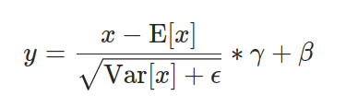
The BatchNorm2d layer
BatchNorm2d is a technique to normalize the input of each layer.
It operates on batches of data and normalizes the input by subtracting the mean and dividing by the standard deviation.
This normalization helps in stabilizing and accelerating the training process.

Slide 18
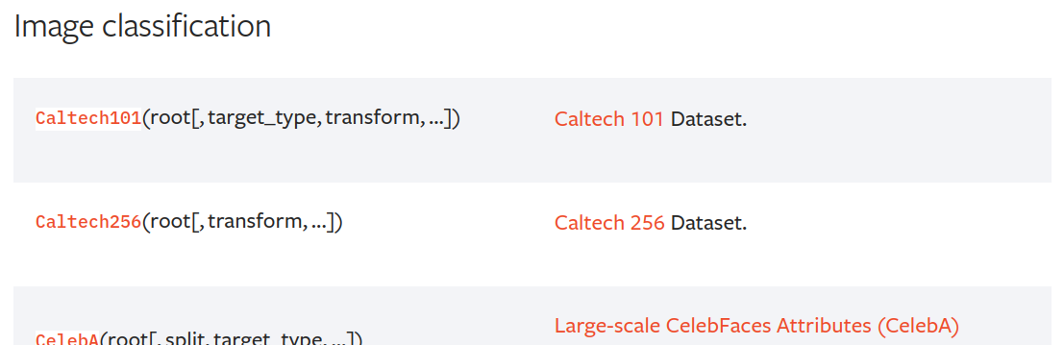
torchvision.datasets
torchvision.datasets is a module that provides a collection of popular datasets for computer vision tasks.
It simplifies the process of loading and preprocessing these datasets, making them readily available for researchers and practitioners working on image-related tasks.

Slide 19
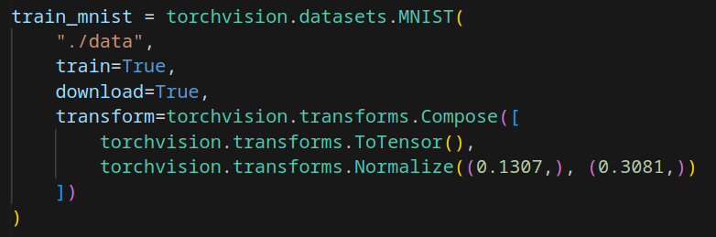
The MNIST Dataset
The MNIST dataset is a widely used collection of handwritten digits.
It consists of grayscale images, each depicting a single digit (0 through 9).
The dataset contains 60,000 training images and 10,000 testing images, each of size 28x28 pixels.

Slide 20
Exercise 0
Train a three-layers MLP to solve the MNIST classification problem
Each MNIST image is 1x28x28, reshape it to 768
The MLP should have 300 hidden neurons
The MLP should have 10 output neurons, one per each class
Use the LeakyReLU activation function
Use the CrossEntropyLoss loss function

Slide 21
Exercise 1
Bonus: plot a 2D PCA of the feature vectors
Train a CNN without residual blocks
The CNN given an input MNIST image should output a feature vector
Train the network in a way that euclidean distance between feature vectors of different classes is the same as the difference between the classes
6
CNN
Dist
Train this to be 6 - 4 = 2
4
CNN

Slide 22

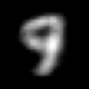
Exercise 2
Train a ResNet
The ResNet given an input MNIST image should output a image with the same shape
The output image should depict the successive number w.r.t. the input one
ResNet

